Slide 1
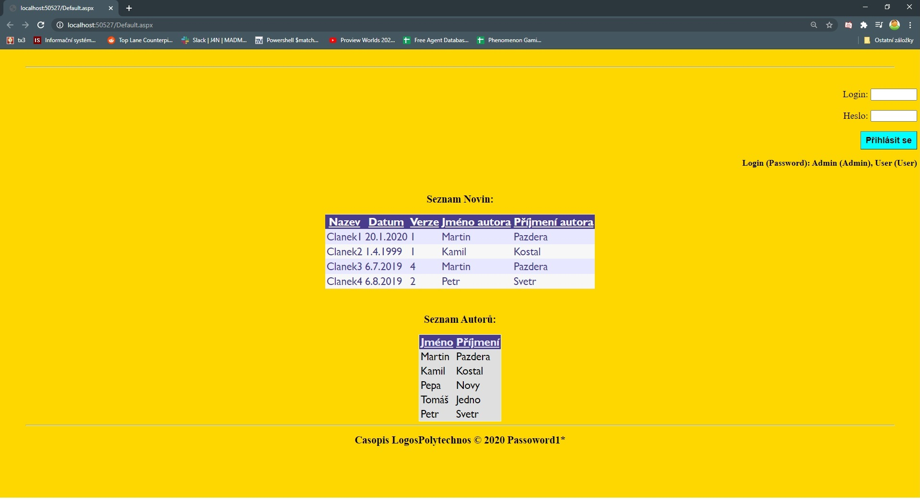
Homepage

Slide 2
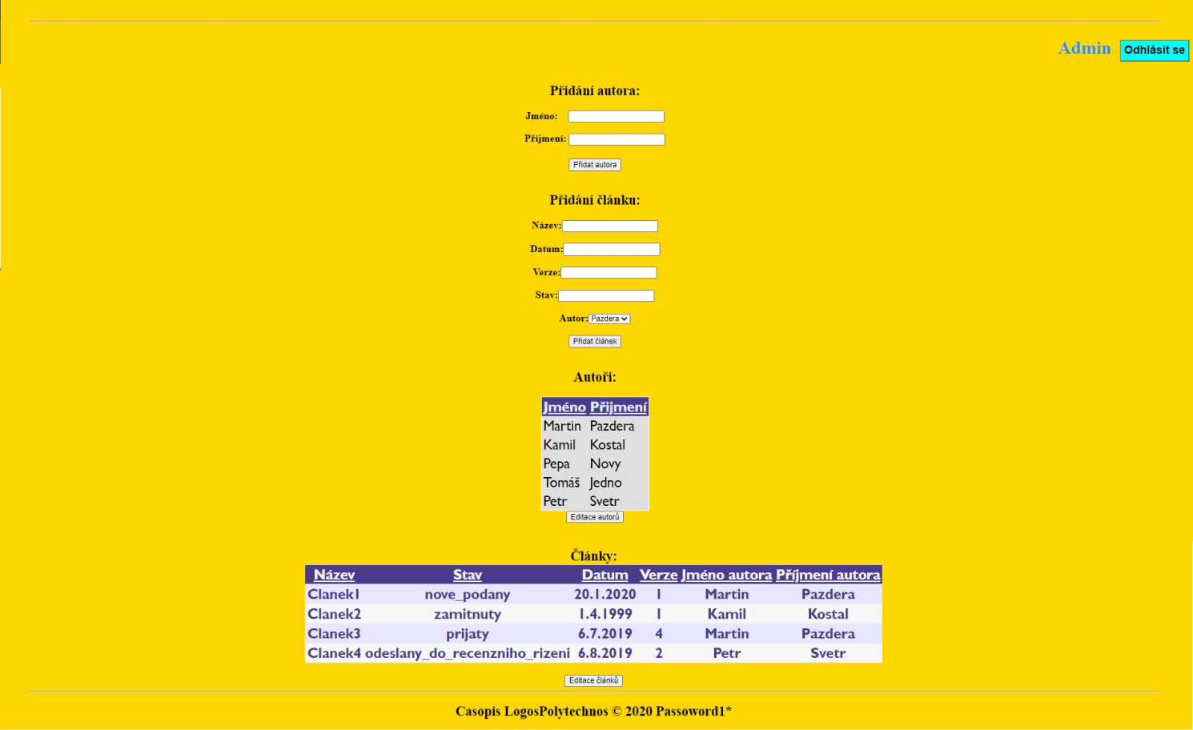
Admin

Slide 3

Redaktor

Slide 4

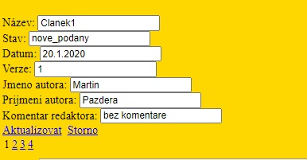
Editace tabulek

